Slide 1
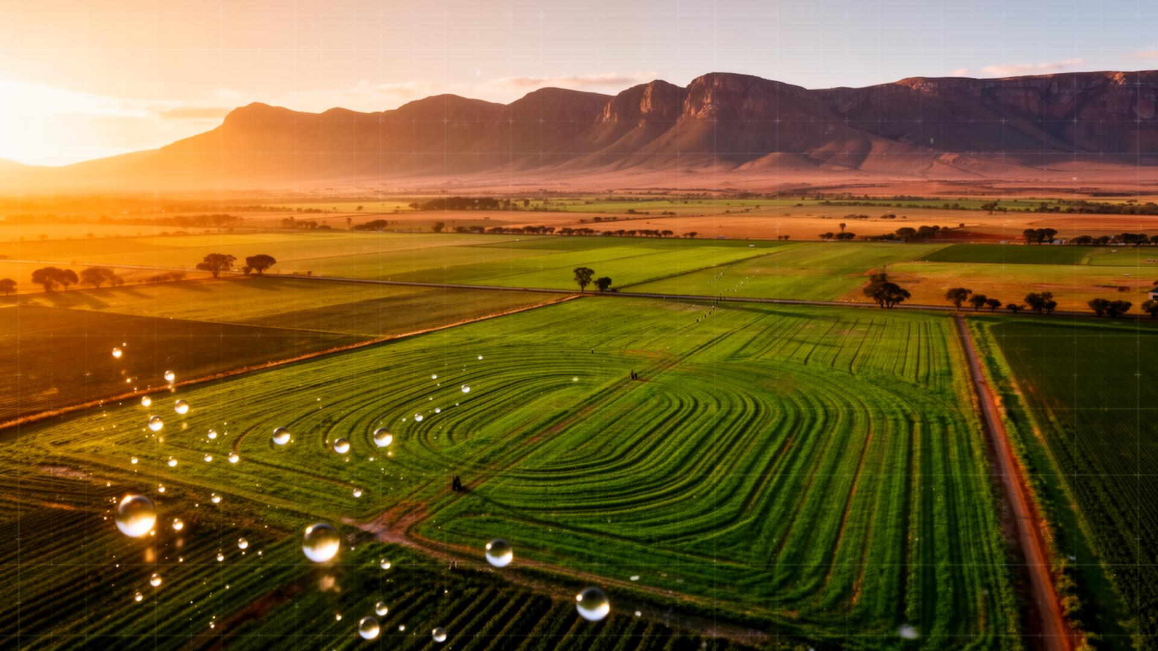
CAPSTONE PROJECT
AgriSense.AI
Solving South Africa's water crisis in agriculture, one photo at a time.
AI Diagnosis · Water Solutions · Urban + Rural Farmers
Built with TanStack Start · Lovable Cloud · Google Gemini 2.5 Flash

Slide 2
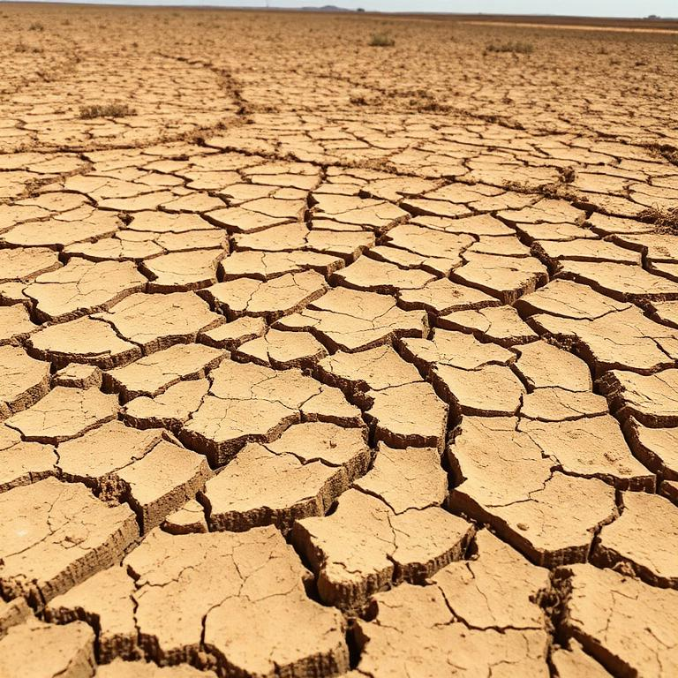
THE PROBLEM
South Africa is running dry.
60%
of SA's freshwater
goes to agriculture
98%
of available water
is already allocated
1 in 3
municipalities face
weekly water cuts
AgriSense.AI · AI for South African Agriculture & Water
1 / 14

Slide 3
CONTEXT
Two farmers. One platform.
Urban Smallholder
Rural Commercial Farmer
Soweto, Khayelitsha, Mamelodi
Free State, Limpopo, Eastern Cape
Backyard & community gardens
Tomatoes, spinach, peppers, herbs
Limited water, no extension officer
Smartphone-first, low data budget
Maize, livestock, citrus, vines
Boreholes, dams, drip & flood irrigation
Load-shedding hits pumps & cold-chain
Needs fast diagnosis at scale
AgriSense.AI · AI for South African Agriculture & Water
2 / 14

Slide 4
THE SOLUTION
AgriSense.AI in one breath.
A web app that lets any South African farmer snap a photo of a sick plant, thin cow, dry soil or leaking pipe — and get an instant, water-first diagnosis with a 3-step action plan.
📷
💬
💧
🔗
Diagnose
AI Advisor
Water-First
Connected
Image AI for crops, livestock, soil & water.
Chat for SA-specific agronomy questions.
Every answer prioritises saving water.
Links farmers to finance, transport & markets.
AgriSense.AI · AI for South African Agriculture & Water
3 / 14

Slide 5

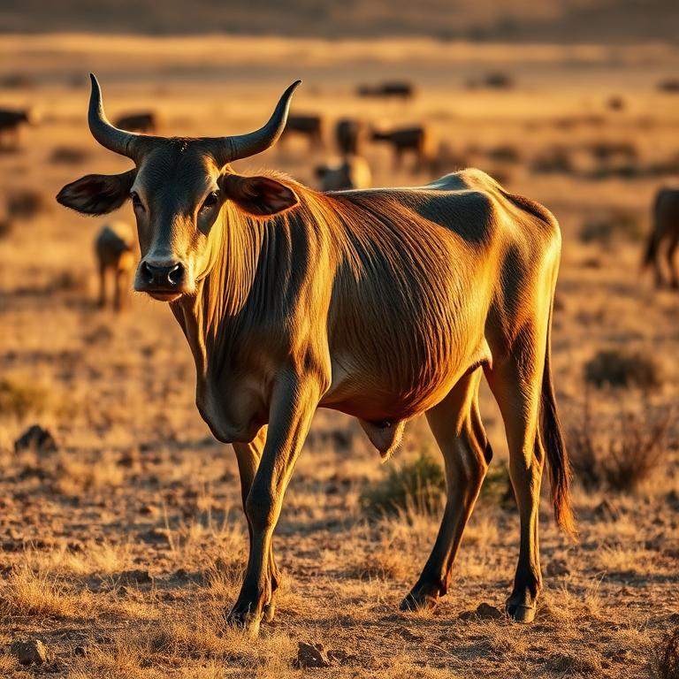
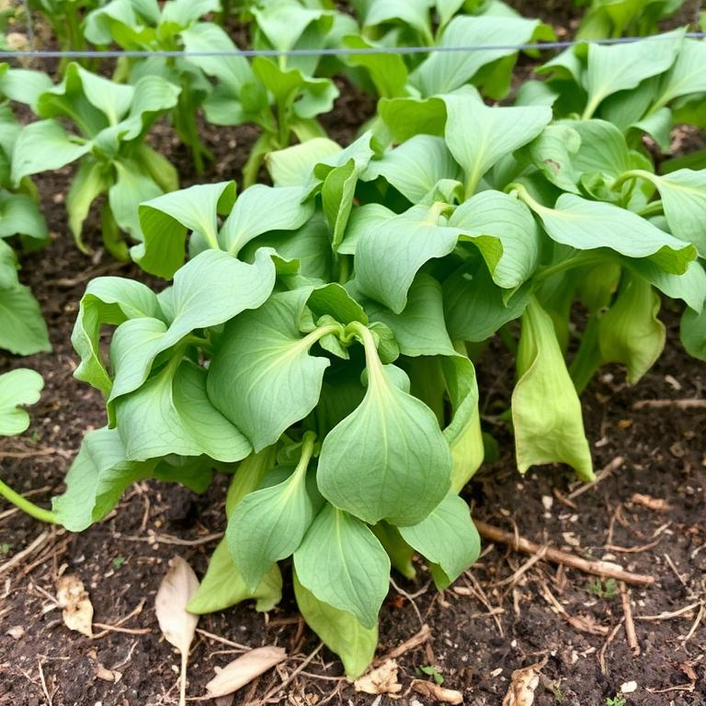
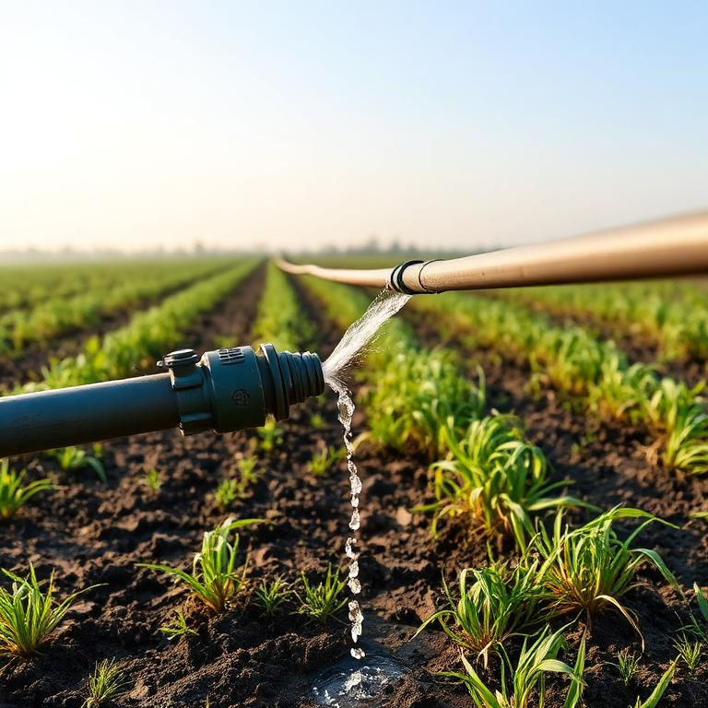
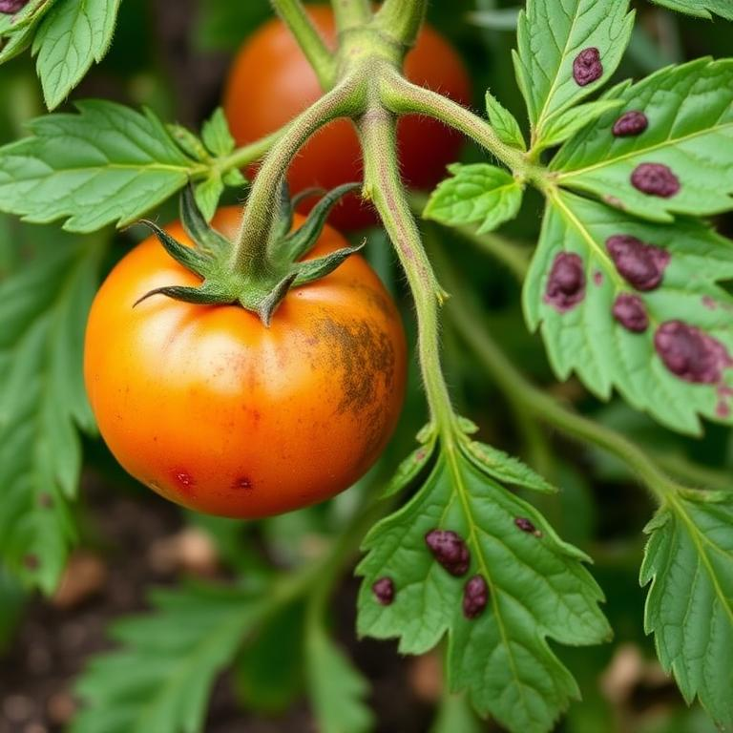
WHAT'S NEW
One-tap sample diagnosis.
Six clickable demo images — judges & first-time farmers can experience the AI without uploading a single file.
🌽 Sick maize leaf
🐄 Underweight cattle
🌱 Wilted vegetables
💧 Leaking irrigation
🟫 Cracked dry soil
🍅 Tomato blight
AgriSense.AI · AI for South African Agriculture & Water
4 / 14

Slide 6
DEMO 1
🌽 Maize leaf — nitrogen + water stress
AI Diagnosis
Yellowing between the veins on lower leaves with a V-shape from the tip suggests nitrogen deficiency, often worsened by water stress. Soil is likely dry to root depth.
Immediate (today)
Deep-water at root zone in early morning. Mulch with dry grass to lock moisture.
This week
Side-dress 30 g LAN per plant after rain. Scout daily for fall armyworm.
Long-term
Rotate with cowpea/legume next season; install drip on this block.
📸 Uploaded by farmer · Diagnosed by Gemini 2.5 Flash
AgriSense.AI · AI for South African Agriculture & Water
5 / 14

Slide 7
DEMO 2
🐄 Underweight Nguni — BCS 2/5
AI Diagnosis
Visible ribs, sunken flanks and dull coat. Body Condition Score around 2 out of 5. Likely protein and energy shortfall on dry winter veld.
Immediate (today)
Move to shaded camp with clean trough water within 200 m of grazing.
This week
Supplement 500 g/day protein lick (urea-based). Deworm and check ticks.
Long-term
Reduce stocking rate; oversow with Eragrostis for winter standing hay.
📸 Uploaded by farmer · Diagnosed by Gemini 2.5 Flash
AgriSense.AI · AI for South African Agriculture & Water
6 / 14

Slide 8
DEMO 3
🟫 Cracked dry soil — severe moisture loss
AI Diagnosis
Wide polygonal cracks indicate clay soil that has lost most of its water. Capillary rise is exposing the root zone — seedlings will scorch.
Immediate (today)
Cover bare soil with 5 cm mulch (straw, cardboard, leaves) before noon.
This week
Build shallow swales across slope; harvest greywater into a 200 L drum.
Long-term
Switch to drip + plant cover crops (sun hemp) to rebuild organic matter.
📸 Uploaded by farmer · Diagnosed by Gemini 2.5 Flash
AgriSense.AI · AI for South African Agriculture & Water
7 / 14

Slide 9
AI ADVISOR
Chat: a farmer in Limpopo at 06:12.
Sawubona. My borehole is giving brown water and my tomatoes wilt by 10am. What do I do?
Sanibonani. Brown borehole water = iron/sediment after a heavy draw or low water table. Don't irrigate tomatoes with it directly.
• Today: Pump 10 min into a settling drum, let it stand 2 hrs, water from the top.
• This week: Fit a 50-micron sediment filter at the outlet (R350 at most co-ops).
• Long-term: Test borehole yield + harvest rainwater (~2 000 L per 20 mm rain on 100 m²).
Eish, and the wilting?
10am wilt with cool nights = water stress + heat, not disease yet. Mulch with 5 cm dry grass, add 40% shade-cloth, water at 5am only. If leaves curl upward tomorrow, send a photo.
AgriSense.AI · AI for South African Agriculture & Water
8 / 14

Slide 10
MARKET SCAN
Three apps already in the field.
Plantix
Aerobotics
Khula!
Crop disease photo ID
Drone + AI for orchards
Marketplace for SA smallholders
Strength
Strength
Strength
Huge image library
High-precision, used by SA citrus
Connects farmers to buyers
Gap
Gap
Gap
No SA water focus, no livestock
Enterprise-only, expensive
No diagnosis or agronomic advice
AgriSense.AI = water-first + crops + livestock + soil + irrigation, in one free app.

Slide 11
ECOSYSTEM
Manufacturing
Agriculture touches every sector.
Agro-processing, packaging, agri-tech
Water
Transport
60% of national water → smarter irrigation
Cold-chain & rural roads to market
Agriculture
Finance
Energy
Crop loans, insurance, micro-credit
Pumps & cold rooms hit by load-shedding
Health
Food security & nutrition outcomes
AgriSense.AI · AI for South African Agriculture & Water
9 / 14

Slide 12
SYSTEM DESIGN
How it works under the hood.
1. Client (TanStack Start + React 19)
Routes: /, /diagnose, /advisor, /insights · Tailwind v4 · sonner · react-markdown
2. Edge (Lovable Cloud)
Supabase Edge Function `agri-ai` · CORS · request validation · error mapping (402/429)
3. AI (Lovable AI Gateway)
google/gemini-2.5-flash · multimodal (text + image_url) · system prompt = SA water-first agronomist
4. Storage (future)
Supabase Postgres + Storage for diagnosis history, farm profiles, RLS by user
Photo → /diagnose → fileToBase64 → supabase.functions.invoke('agri-ai') → Gemini → markdown plan → ReactMarkdown render
AgriSense.AI · AI for South African Agriculture & Water
10 / 14

Slide 13
WATER PLAYBOOK
How AgriSense actually saves water.
💧
Drip + mulch defaults
🌧️
Rainwater harvesting
Every irrigation answer leads with drip and 5cm mulch — cuts use 30–60%.
Calculates litres-per-roof and recommends JoJo sizes by district rainfall.
🪣
Greywater reuse
📅
Time-of-day scheduling
Safe-use guidance for kitchen/laundry water on non-edible parts.
Suggests pre-dawn watering windows aligned to load-shedding stages.
🩺
Leak detection
🌱
Drought-tolerant choices
Photo-diagnoses leaking pipes, valves and float-valves with fix-it steps.
Recommends sorghum, cowpea, amaranth swaps for high-water crops.
AgriSense.AI · AI for South African Agriculture & Water
11 / 14

Slide 14
ROADMAP & ASK
From hackathon to harvest.
1
Now
Web app live · 6 sample diagnoses · AI advisor chat
2
Next 30 days
isiZulu + Sesotho · offline PWA · WhatsApp bot
3
6 months
Soil moisture sensor integration · weather alerts · co-op partnerships
4
12 months
On-device vision for zero-data farms · finance & insurance hooks
Try it now → aqua-agro-wise.lovable.app
AgriSense.AI · Water-first AI for South African agriculture

